Slide 1
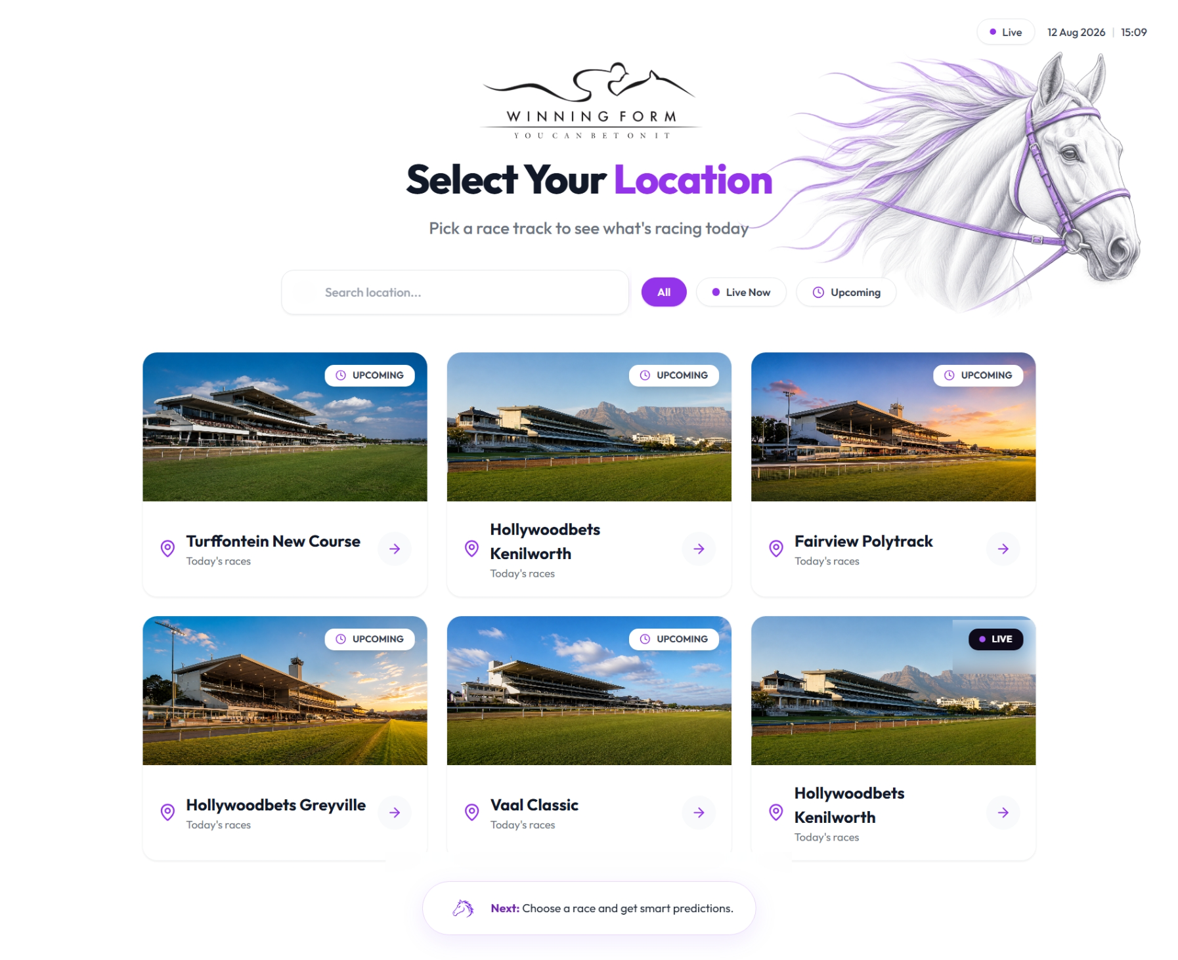
Page 1 - Banele
Add dates
Add times
Updates cards to be like Phumes

Slide 2
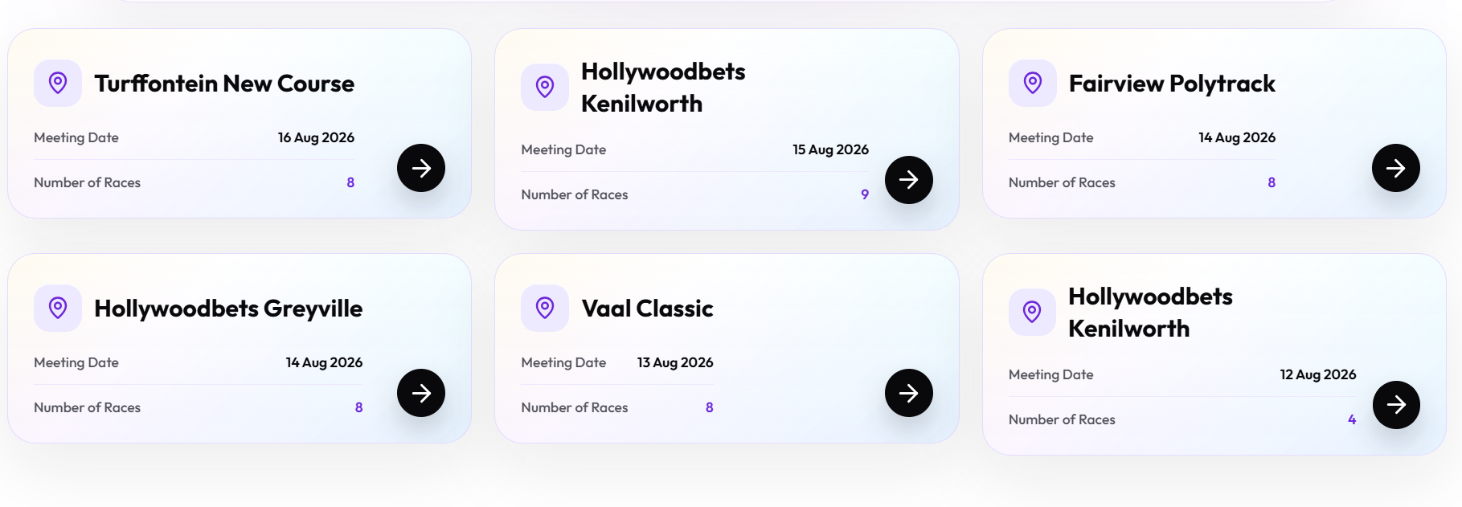
First page blocks layout

Slide 3
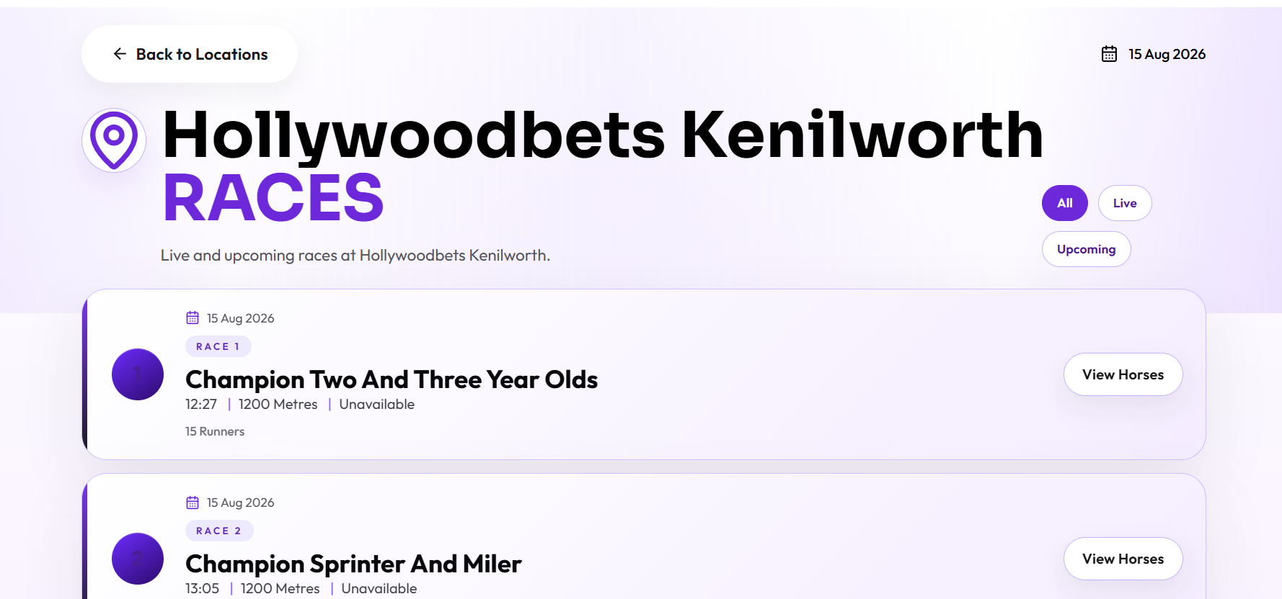
Page 2- Thando -update each race block to be like the landing page

Slide 4
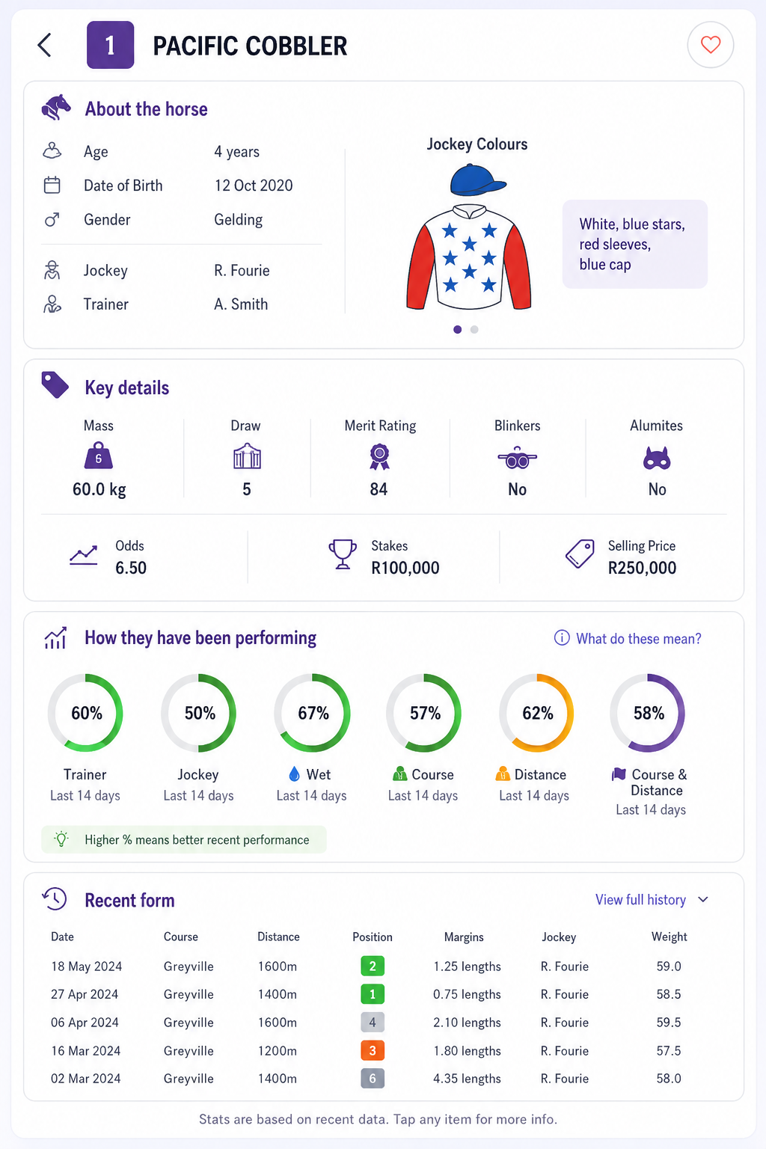
Page 4- Phume
Mbali ( add these in backend)
Numbering same as horse number
Percentages
Display wins and placements.

Slide 5
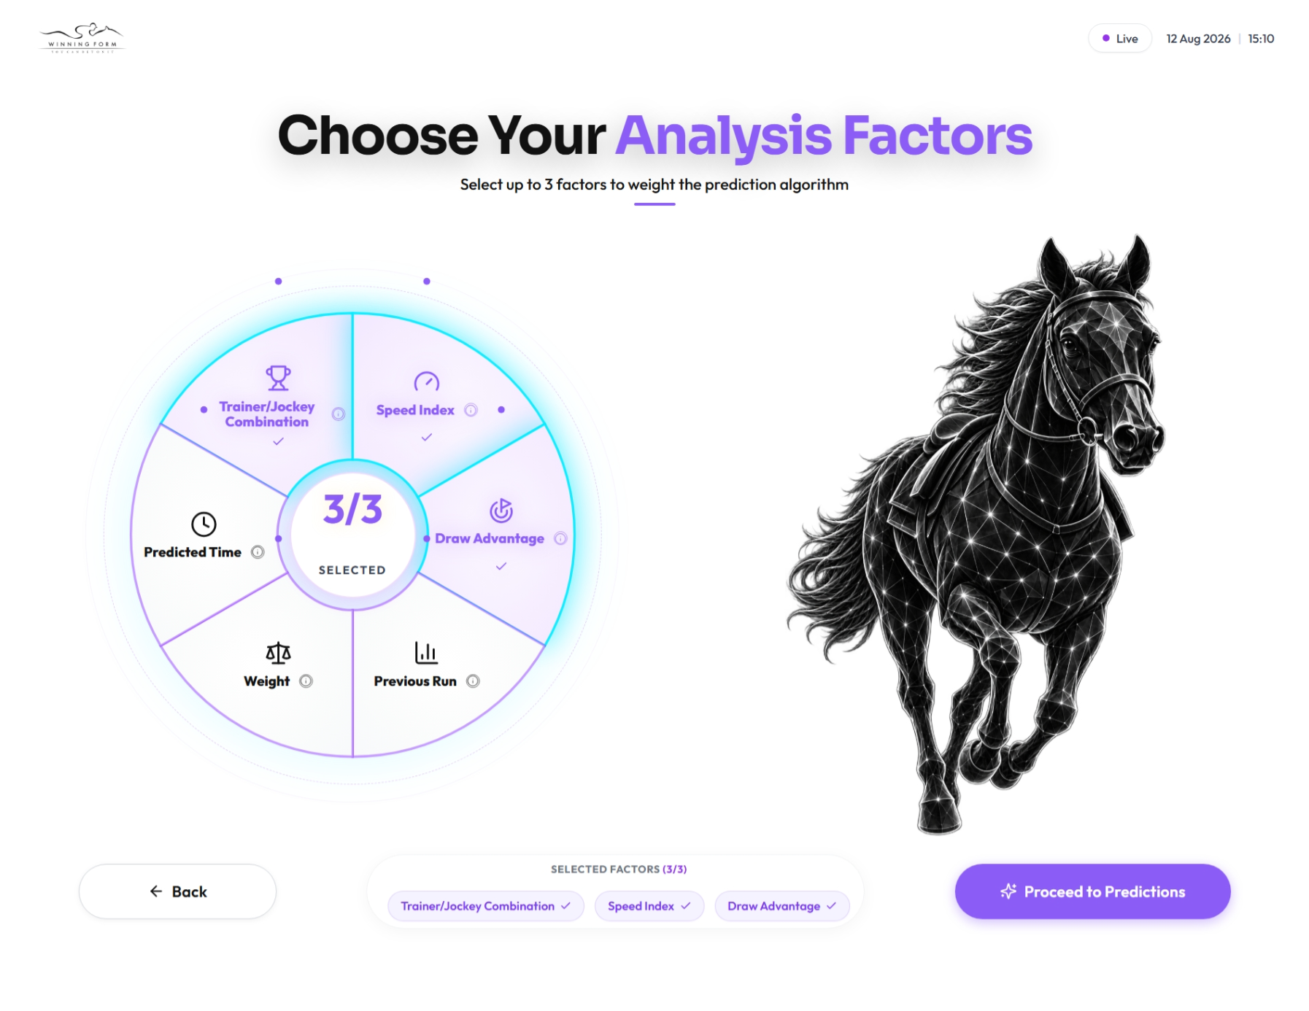
Page 5- Banele
Alignment
Purple highlight instead when selecting

Slide 6
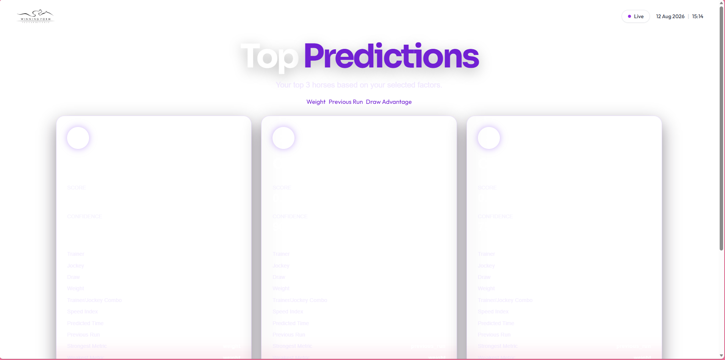
Phume – Page 6
Make it readable

